Slide 1

Web Applications – part 2
Trainers: Daniela-Oana BESLIU
Mihai VADUVA
Andrei Marica
Tekin Omer-Ali
Author: Viorel TACLICIU
Adrian DAFINOIU

Slide 2

Contents
Java Server Pages (JSP)
RequestDispatcher
Filters
Sessions
Q&A

Slide 3
Java Server Pages (JSP)

Slide 4
Java Server Pages
The problems with Java Servlets
The presentation code (HTML) and business logic are closely coupled within java servlet
Writing a lot of source code to display a simple HTML page
If we need to modify the HTML then we’ll have to modify the servlet source code
The mix between business logic source code and HTML makes a servlet hard to modify and also to maintain
Notes:
response.setContentType("text/html");
PrintWriter out = response.getWriter();
out.println("<html>"); out.println("<body bgcolor=\"lightblue\">");
out.println("<head>");
out.println("<title> An html from servlet example </title>");
out.println("</head>");
out.println("<body>");
out.println("<h1> An example page 1</h1>");
out.println("</body>");
out.println("</html>");
out.close();

Slide 5

Java Server Pages
a technology for developing web pages that support dynamic content which helps developers insert java code in HTML pages by making use of special JSP tags, most of which start with <% and end with %>.
are built on top of the Java Servlets API, so like Servlets, JSP also has access to all powerful APIs
JSP pages can be used in combination with servlets that handle the business logic, the model supported by Java servlet template engines.

Slide 6
JSP - Advantages
Separation of dynamic and static content
Web developer creates and maintains the HTML content
Java programmer creates and maintains dynamic content and business logic
Component reuse
Speeds up website development and support
Platform independence
Is Java -> promotes portability on several systems

Slide 7
JSP - Structure
JSP Elements
JSP Declarations :: Code that goes outside the service method
JSP Scriptlets :: Code that goes within the service method
JSP Expressions :: Code inside expressions is evaluated
JSP Directives :: Commands given to the JSP engine

Slide 8
JSP - Declarations
What are declarations?
Whatever goes inside the “<%!{JAVA_HERE}%>” tags is called a declaration
Everything you write in a declarations goes outside the service method
Treat them as instance methods and instance variables
What do you declare in declarations?
You can declare methods and variables in declarations
Why do you need declarations?
You have any variable that needs to be shared across different requests.
You have repeated common code in you jsp, declare it in a method.

Slide 9
JSP - Declarations
Example of declaration:
<html>
<body>
<%! int data=50; %>
</body>
</html>

Slide 10
JSP - Scriptlets
What are declarations?
Whatever goes inside the “<%{JAVA_HERE}%>” tags is called a scriptlet
Everything you write in a scriptlets goes in the service method
Treat variables in scriptlets as method/local variables
What do you put in scriptlets?
Business logic in JSPs are put in scriptlets. Set of java statements
Why do you need scriptlets?
Need to perform some small business logic (if logic is complex, do in java)
Need to perform some basic validations

Slide 11
JSP - Scriptlets
Example of scriptlet:
<html>
<body>
<%
// This is a scriptlet.
System.out.println( “Enjoy Zero To Hero" );
java.util.Date today = new java.util.Date();
%>
Today is <%= today %>
</body>
</html>

Slide 12

JSP - Expressions
What are expressions?
Whatever goes inside the “<%={JAVA_HERE}%>” tags is called an expression
Code inside expressions is evaluated, and output is displayed
Whatever is put inside expressions should evaluate to a value
What do you put in scriptlets?
Variables or methods that return some values
Why do you need scriptlets?
Need to print some text onto the page

Slide 13
JSP - Expressions
<html>
<body>
<%! int data=50; %>
<%= "Value of the variable is:"+data %>
</body>
</html>

Slide 14
JSP - Directives
What are directives?
Whatever goes inside the “<%@{DIRECTIVES}%>” tags is called a directive
Directives gives pre-processing commands to the JSP Engine.
Everything in directives are processed before JSP is translated to Servlet
What do you put in directives?
Processing commands to the JSP Engine.
Why do you need directives?
To incorporate certain additional features into the JSP
Modifying the Servlet behaviour generated from the JSP
Include other html/jsp files in the JSP.
Provide tag libraries

Slide 15
JSP - Directives
Page directive
<%@ page language=“java” %>
<%@ page import=“java.util.*” %>
Include directive
<%@ include file=“copyright.html” %>

Slide 16
JSP - Model
How a JSP is executed
HTTP server receives request for .jsp file
The .jsp file is located (can be in any directory)
Tomcat is called and passed the .jsp file
A servlet is created based on JSP code (that may include also java code beside HTML)
The servlet .java and .class files are written to disk, internal to Tomcat under the folder %CATALINA_HOME%\work\Catalina\<your_application>\org\apache\jsp
The .class file is processed by the JVM within Tomcat like any other servlet
HTML code is generated by the servlet and returned
Notes:
When a JSP is requested for the first time or when the webapp starts up, the servlet container will compile it into a class extending HttpServlet and use it during the webapp's lifetime. You can find the generated source code in the server's work directory. In for example Tomcat, it's the /work directory. On a JSP request, the servlet container will execute the compiled JSP class and send the generated output (usually just HTML/CSS/JS) through the webserver over network to the client side, which in turn displays it in the web browser.

Slide 17
JSP - Model
<%@ page import=“foo.*” %>
<html>
<body>
<% int i = 10; %>
<%! int count = 0; %>
Hello! Welcome
<%! Public void display()
{
out.println(“Hello”);
} %>
</body>
</html>
import javax.servlet.HttpServlet.*
import foo.*;
public class MyJsp_jsp extends
HttpServlet
{
int count = 0;
public void display()
{
out.println(“Hello”);
}
public void _jspService(req, res)
{
int i = 0;
out.println(“<html>\r<body>”);
out.println(“Hello! Welcome”);
}
}
Notes:
When a JSP is requested for the first time or when the webapp starts up, the servlet container will compile it into a class extending HttpServlet and use it during the webapp's lifetime. You can find the generated source code in the server's work directory. In for example Tomcat, it's the /work directory. On a JSP request, the servlet container will execute the compiled JSP class and send the generated output (usually just HTML/CSS/JS) through the webserver over network to the client side, which in turn displays it in the web browser.

Slide 18
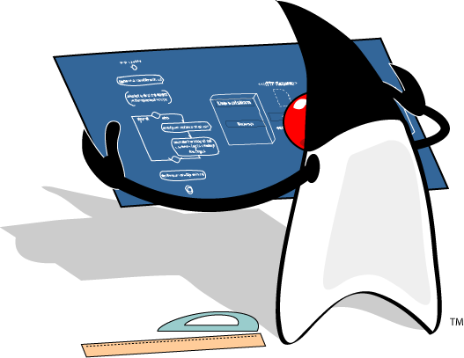
JSP - Workshop
Open file WorkShop 1 - JSP - 1.0.docx
Begin workshop

Slide 19
RequestDispatcher

Slide 20
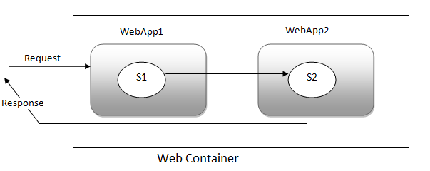
RequestDispatcher
Notes:
The request dispatcher is used for receiving requests from the client and sending them to any resource (such as a servlet, HTML file, or JSP file) on the server.
The most common approach is forward or include resource to the client.
The servlet container creates the RequestDispatcher object, which is used as a wrapper around a server resource located at a particular path or given by a particular name.

Slide 21
RequestDispatcher - Interface
An interface that provides the facility of dispatching the request to another resource
The resource called can be HTML, Servlet or JSP
HttpServletRequest & RequestDispatcher
Enables your servlet to "call" another servlet from inside another servlet
The other servlet is called as if an HTTP request was sent to it by a browser
A RequestDispatcher can be obtained from the HttpServletRequest object

Slide 22
RequestDispatcher
Getting a RequestDispatcher
protected void doPost(HttpServletRequest request,
HttpServletResponse response)
throws ServletException, IOException {
RequestDispatcher requestDispatcher =
request.getRequestDispatcher("/nextURL");
}
Call RequestDispatcher using either include() or forward() method:
requestDispatcher.forward(request, response);
requestDispatcher.include(request, response);

Slide 23
RequestDispatcher & HttpServletRequest
You can share data between two servlets by adding and retrieving attributes using the request object. In this case, the scope of the attributes will be “request”
Method from HttpServletRequest:
public void setAttribute(String name, Object o);
Example:
Setting attribute:
request.setAttribute("someAttribute", "someAttributeValue");
RequestDispatcher requestDispatcher =
request.getRequestDispatcher("/nextURL");
requestDispatcher.forward(request, response);
Getting attribute:
request.getAttribute("someAttribute");

Slide 24
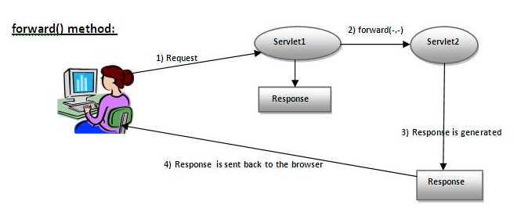
RequestDispatcher - forward()

Slide 25
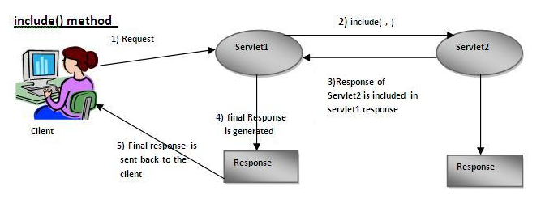
RequestDispatcher - include()

Slide 26
RequestDispatcher - workshop
Open file WorkShop 2 - RequestDispatcherWorkshop.docx
Begin workshop

Slide 27
Servlet Filters

Slide 28
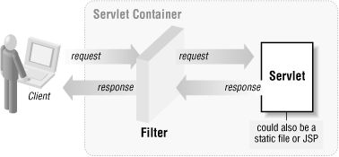
Servlet Filters
What are Servlet Filters?
Java classes that can be used in Servlet Programming for:
Intercepting requests from a client before they access
a resource from the backend
Manipulate responses from server before they are sent
back to the client

Slide 29
Servlet Filters
Various types of filters:
Authentication Filters
Data compression Filters
Encryption Filters
Filters that trigger resource access events
Image Conversion Filters
Logging and Auditing Filters
When the web container starts up your web application, it creates an instance of each filter that you have declared in the deployment descriptor.
The filters execute in the order that they are declared in the deployment descriptor.
If there is more than one filter, then we’ll have a chain of filters.
Notes:
Filters are defined and then mapped to a URL or Servlet, in much the same was as Servlet is defined and then mapped to a URL pattern.

Slide 30
Servlet Filters
In order to create a filter you should use the following instructions:
Implement interface Filter from javax.servlet package
2. Implement method init().
3. Implement method public void doFilter (ServletRequest, ServletResponse, FilterChain); In this method if you want to continue with the other filters in the chain add al the last code line the following instrunction chain.doFilter(request, response);
4. Implement method public void destroy()
Notes:
1. Implement interface Filter from javax.servlet package
2. Implement method init(). In the implementation you can add several configurations to your filter. This method is called by the container once, when the filter is initialized
3. Implement method
public void doFilter (ServletRequest, ServletResponse, FilterChain)
Beside the request and response objects found also in the Servlets implementation, we have a FilterChain object, provided by the Servlet Container, so that we can manage our filter chain
4. Implement method public void destroy() in order to release some resources used in our init() method encapsulated in the filter
Multiple filters can be written and applied to the same URL pattern. The order of execution is determined by the ordering in the deployment descriptor.
Remember that in the doFilter() method you call the next element in the chain with: chain.doFilter(request, response);

Slide 31
Servlet Filters
5. Declare the filter in web.xml deployment descriptor
<filter>
<filter-name>SomeFilter</filter-name>
<filter-class>ro.teamnet.z2h.SomeFilter</filter-class>
<init-param>
<param-name>someInitParam</param-name>
<param-value>Init Parameter Value</param-value>
</init-param>
</filter>
6. Map the Filter to the components/url that you want this filter to apply
<filter-mapping>
<filter-name>SomeFilter</filter-name>
<url-pattern>/someURL</url-pattern>
</filter-mapping>
Notes:
Filters are defined and then mapped to a URL or Servlet, in much the same was as Servlet is defined and then mapped to a URL pattern.
The order in which they are defined matters. The container will execute the filters in the order in which they are defined.

Slide 32
Filters - workshop
Open file WorkShop 3 - ServletFilters.docx
Begin workshop

Slide 33
HTTP Session

Slide 34

HTTP Session
Problem with the HTTP Protocol
It is stateless - it cannot keep the conversational state between requests received from the same user
Fix
The problem was solved by adding a specific attribute to our requests, JSESSIONID
By using this JSESSIONID, the Servlet Container knows how to re-establish the conversational state of the same client between requests
If the request does not contain the JSESSIONID, a new conversational state will be registered to the client by associating a new JSESSIONID
This conversation state is represented in the Servlet API by the type HttpSession

Slide 35
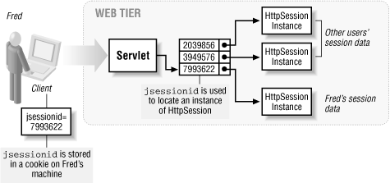
HTTP Session
JSESSIONID can be sent to the client and back to server in 3 different ways:
By using Cookies
By using query string for GET requests
By using input hidden for POST requests
Notes:
Cookies are small piece of information that is sent by web server in response header and gets stored in the browser cookies. When client make further request, it adds the cookie to the request header and we can utilize it to keep track of the session.
URL Rewriting – We can append a session identifier parameter with every request and response to keep track of the session. This is very tedious because we need to keep track of this parameter in every response and make sure it’s not clashing with other parameters.
HTML Hidden Field – We can create a unique hidden field in the HTML and when user starts navigating, we can set its value unique to the user and keep track of the session. This method can’t be used with links because it needs the form to be submitted every time request is made from client to server with the hidden field. Also it’s not secure because we can get the hidden field value from the HTML source and use it to hack the session.

Slide 36
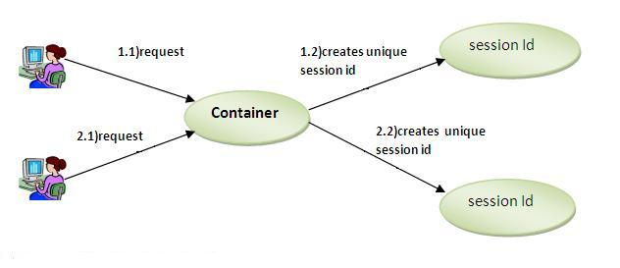
HTTP Session
The HttpServletRequest interface provides two methods to get the object of HttpSession:
public HttpSession getSession():Returns the current session associated with this request, or if the request does not have a session, creates one.
public HttpSession getSession(boolean create):Returns the current HttpSession associated with this request or, if there is no current session and create is true, returns a new session.

Slide 37
HTTP Session
HttpSession object could be retrieved from the current HttpServletRequest object
HttpSession most important methods are:
getAttribute(String name) Returns the object bound with the specified name in this session, or null if no object is bound under the name.
setAttribute(String name, Object value) Binds an object to this session, using the name specified.
getAttributeNames() Returns an Enumeration of String objects containing the names of all the objects bound to this session.
getId() Returns a string containing the unique identifier assigned to this session.
invalidate() Invalidates this session then unbinds any objects bound to it.
removeAttribute(String name) Removes the object bound with the specified name from this session.
setMaxInactiveInterval(int interval) Specifies the time, in seconds, between client requests before the servlet container will invalidate this session.
In our web.xml deployment descriptor file we can set the timeout of all http sessions

Slide 38
HttpSession - workshop
Open file WorkShop 4 - HttpSession.docx
Begin workshop

